Slide 1
Impacts of Covariate Scale and Model Tuning on Maxent Modeling An Example Using Bristlecone Pine Data
Thesis Defense
Cass Kalinski

Slide 2
Presentation Overview
1) Introduction
2) Model Inputs
3) Methods
4) Results
5) Conclusions
6) Questions / Discussion
SECTION TITLE | 2

Slide 3
Introduction

Slide 4
Research Questions
Do higher resolution covariates yield a better performing Maxent model of potential habitat extent?
Does a tuned Maxent model yield a better performing model of potential habitat than a model using the default Maxent settings?
SECTION TITLE | 2
Notes:
Accurate = do the metrics indicate a better fit? But not overfit.
Problem with ENMs: hard to ground truth “accurate”. Have to rely on model metrics.

Slide 5
Motivation
Numerous studies using Maxent without assessing impacts of the model parameters and covariate selection
Increased availability of high resolution datasets but little assessment of appropriateness for species distribution models
SECTION TITLE | 2

Slide 6
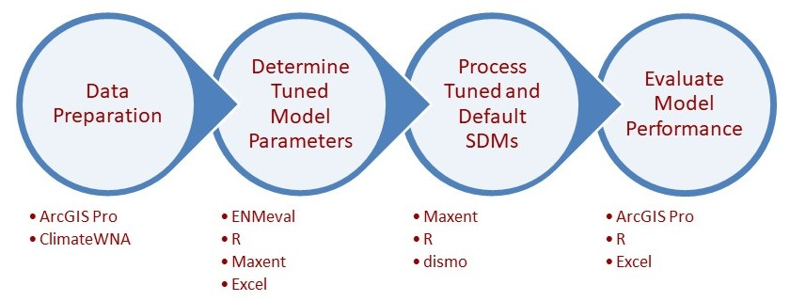
High Level Approach
SECTION TITLE | 2

Slide 7
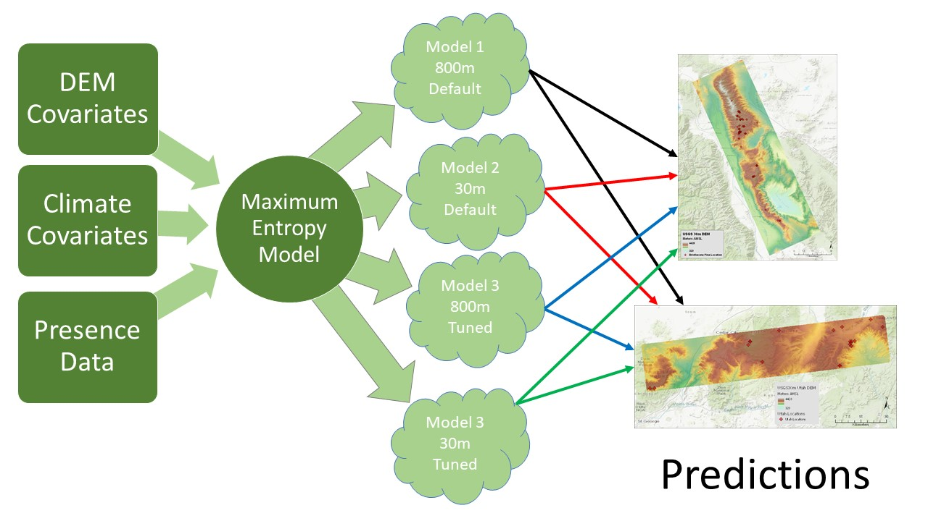
Model Processing
Notes:
Vary covariate resolutions
Two DEM resolutions (30m and 800m)
Climate variables matched to DEM resolution
Tuned versus default MaxEnt model
Use “standard” MaxEnt parameters for default model
Test to develop tuned MaxEnt parameters
Compare and contrast MaxEnt outputs
Four model combinations
Performance metric driven comparisons
Spatial comparison of model outputs

Slide 8
Model
Inputs

Slide 9
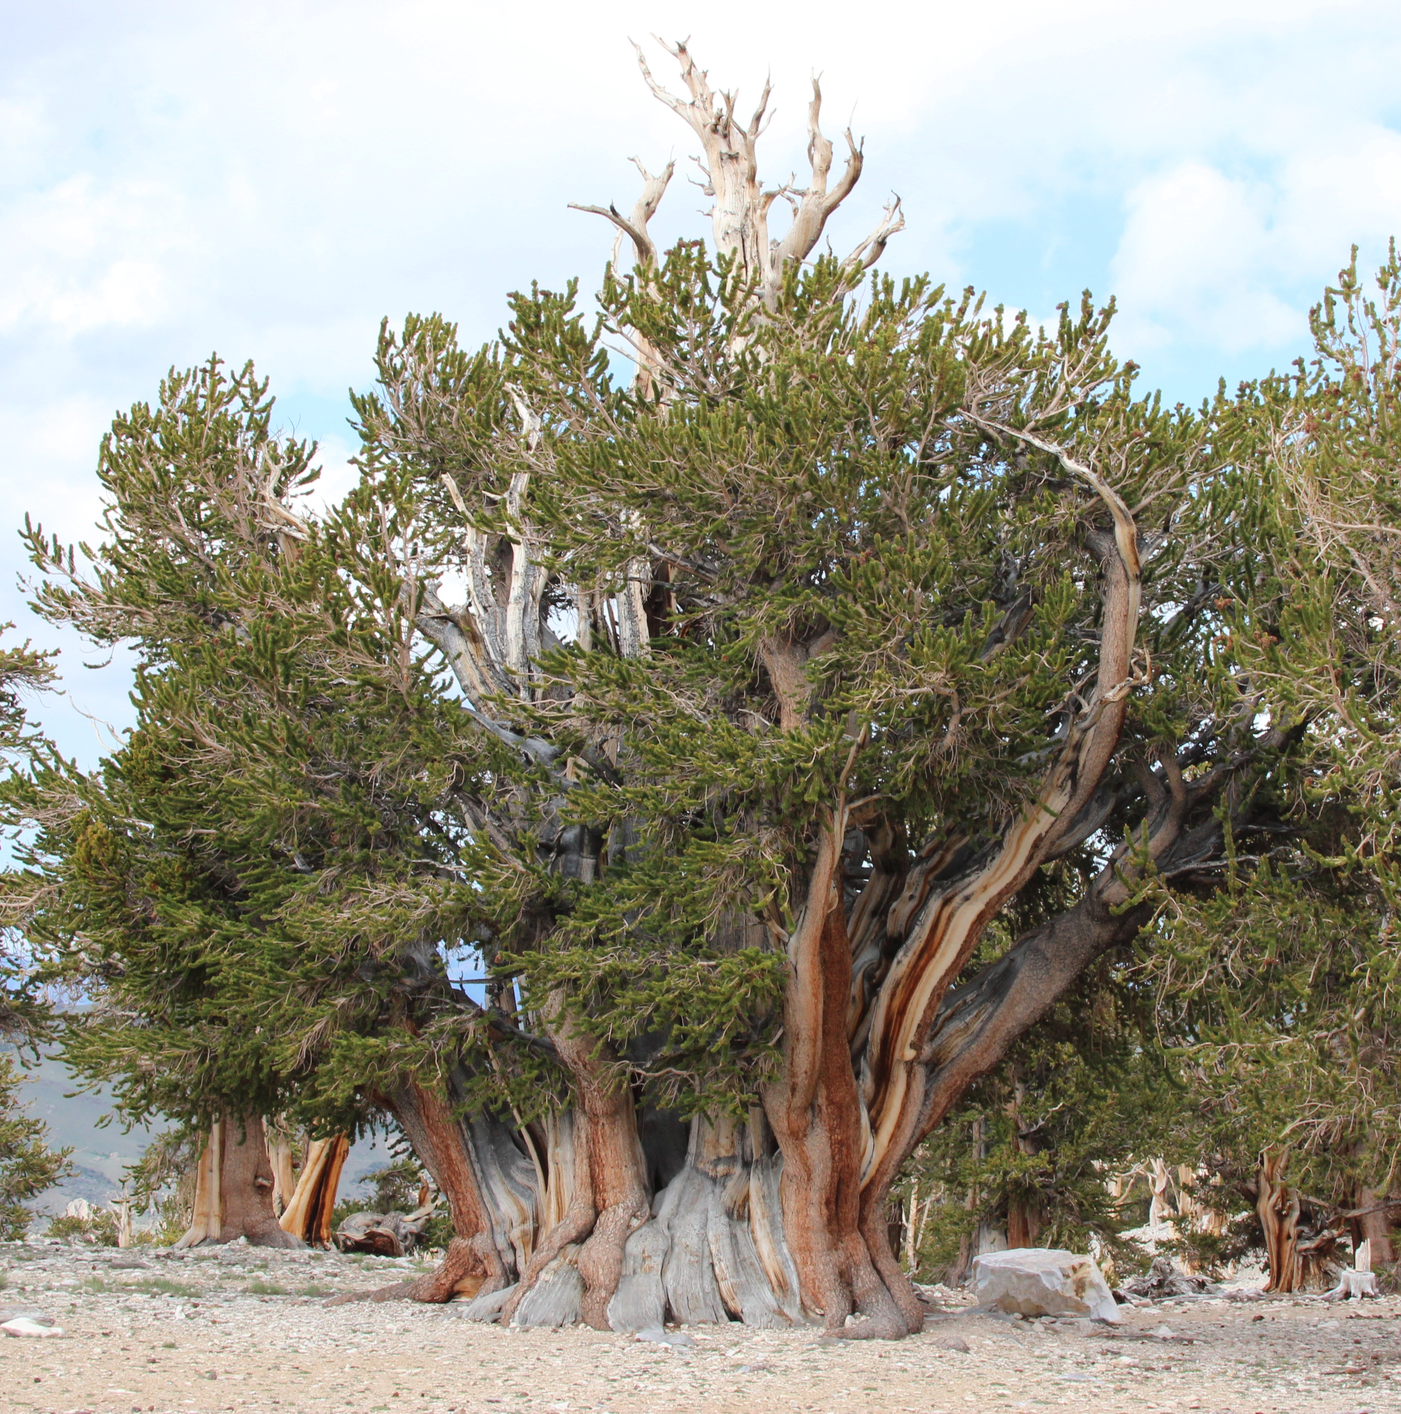
Model Inputs
Presence Data
Bristlecone pine locations from GBIF
Climate Covariates
PRISM climate model
ClimateWNA
Elevation Derived Covariates
USGS 3DEP 30-meter DEM
PRISM 800-meter DEM
SECTION TITLE | 2
Notes:
Explain why this species:
High elevation niche with high relief terrain
Limited habitat range
Small set of key climate variables
Sufficient presence data
GCS North America 1983, NAD 83 datum
North American Vertical Datum of 1988 (NAVD 88)
Vertical resolution of NED 3 arc-sec data appears to be +/-30m. Per specs from 2000 fact sheet. Also references in a couple of other documents.
PRISM DEM
modified Gaussian filter 80m>800m
truly circular averaging area
weights the surrounding grid cells in a Gaussian, or normal, distribution with distance

Slide 10
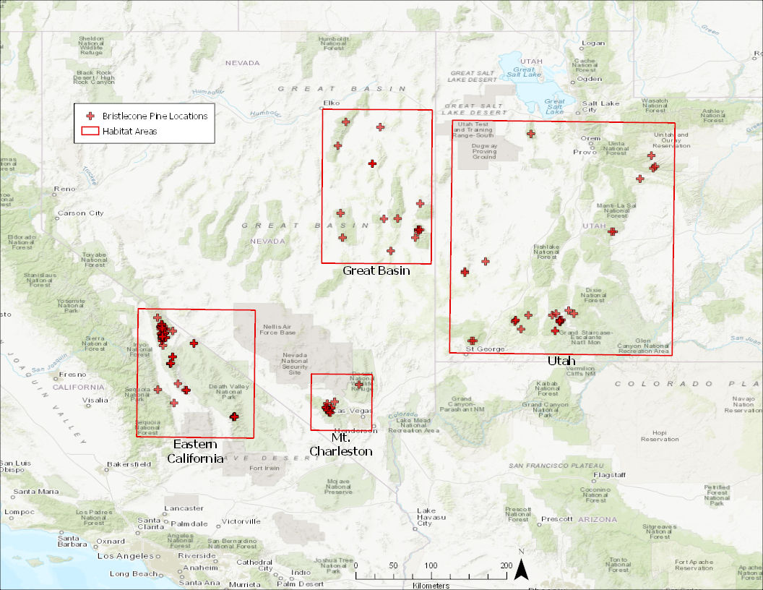
Study Area Selection
4 Major Areas
Eastern California
Great Basin, NV
Mt Charleston, NV
Utah
Area | Count
Easthern California | 109
Great Basin, NV | 23
Mount Charleston, NV | 19
Utah | 29
TOTAL | 180
SECTION TITLE | 2

Slide 11
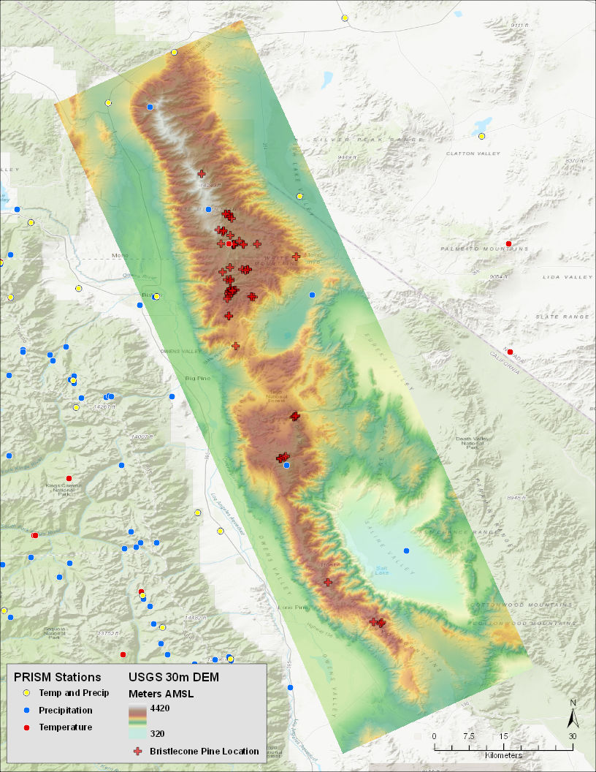
Study Area
White Mountains -
Inyo Mountains
Highest concentration (76)
Good weather station coverage for climate data
~50km x ~185km rectangle
SECTION TITLE | 2

Slide 12
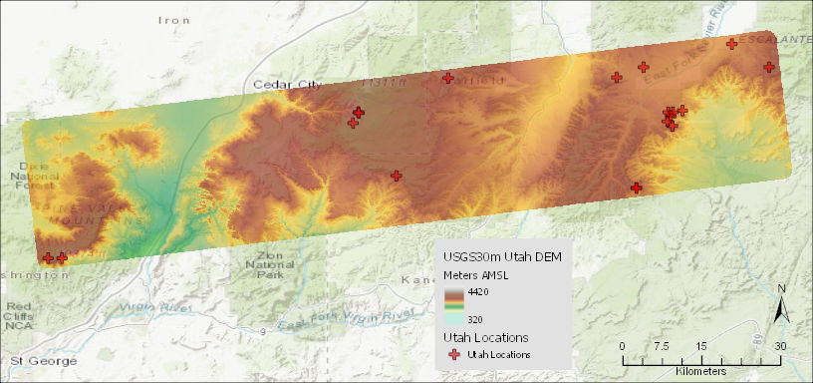
Utah Prediction Area
Secondary area to use as test of model transportability
Similar selection logic as primary study area
Great Basin had more localities (23) but a broader extent
Southern Utah more concise extent and similar count (19)
SECTION TITLE | 2

Slide 13
Data Issues
PRISM “800m” nomenclature confusion
PRISM DEM aggregated from USGS NED 3 arc-sec (90-meter) DEM
USGS NED 90m DEM is +/- 30 meter vertical accuracy
Therefore, PRISM DEM accuracy unknown
Used for elevation covariates in 800m models
Propagates to climate data for both 30m & 800m
In contrast, 30m DEM is 3DEP/high quality
SECTION TITLE | 2

Slide 14
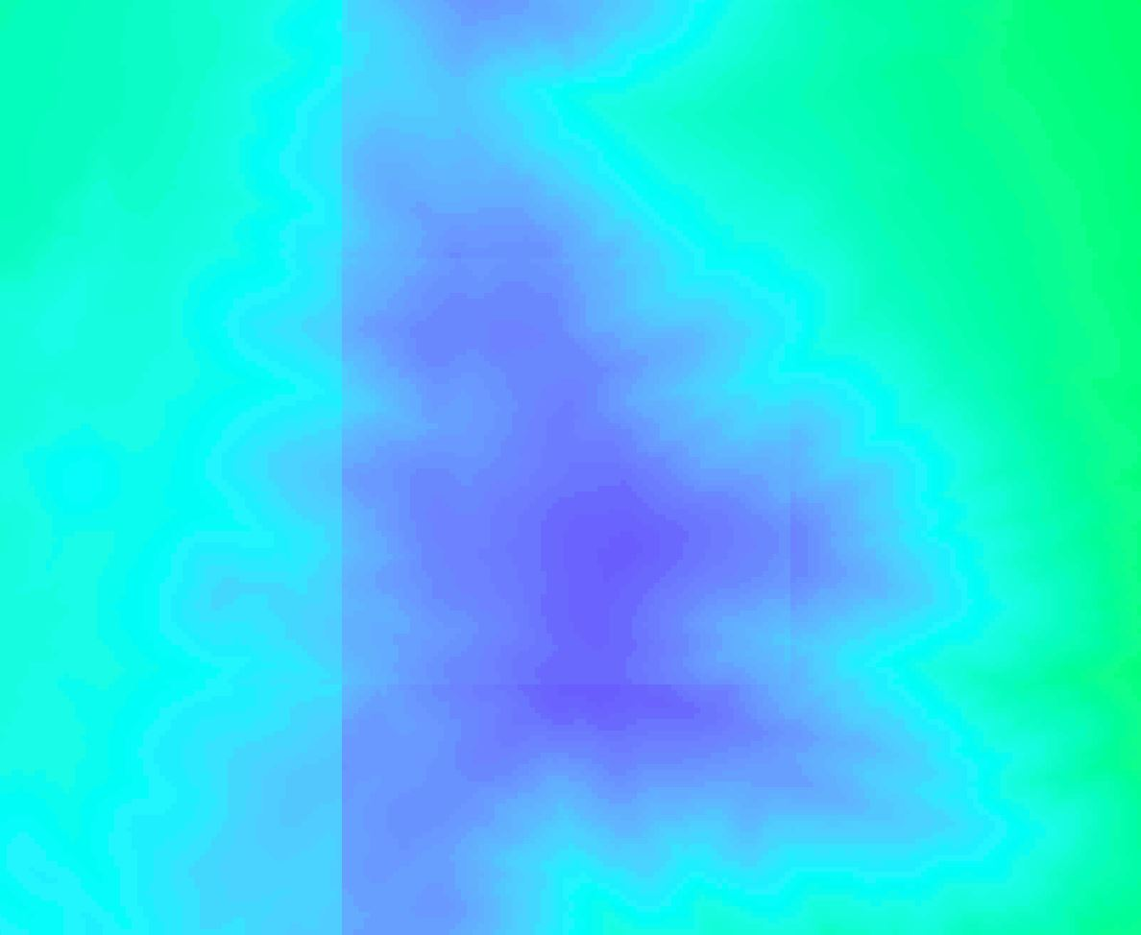
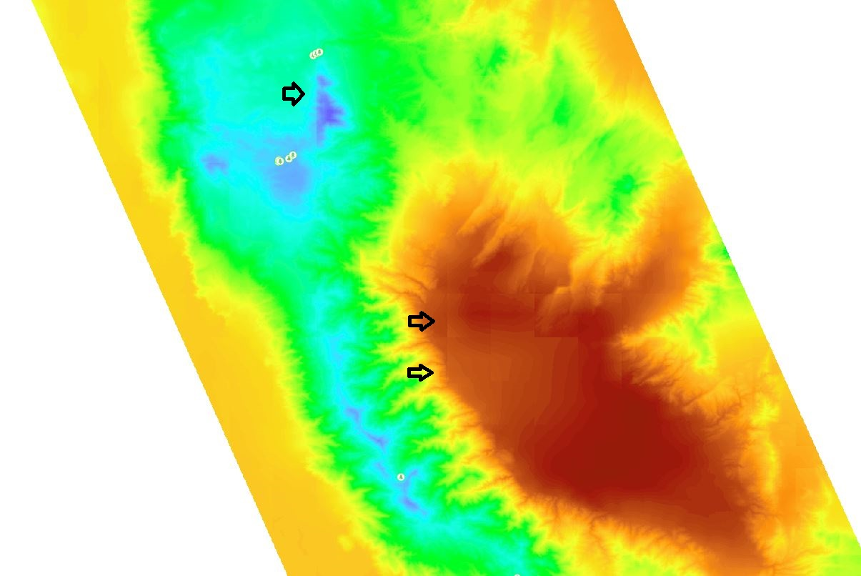
ClimateWNA
Lapse-rate Driven Disaggregation of PRISM
Base PRISM 800-meter data uses more sophisticated modeling
cWNA only uses elevation lapse-rate to estimate finer resolution data
Artifacts in 30m Climate Covariates
Edge effect visible below 200-meter resolution (Confirmed with authors)
For example: 0.5C temp delta (1%-2% of range) in places, nothing in most other locations
SECTION TITLE | 2
Notes:
DO TALK WHY cWNA!!
Artifacts are roughly 2km squares (~2300m N/S by ~1700m E/W)
Options were to use data as is or do a bilinear interpolation to smooth the data. Preference is to use the data as-is.
Both approaches suggested by cWNA principle author, though he suggested the data as-is would still be viable for the intent of the thesis study.
Temp Ranges (adjusted):
OVERALL: -12C to 32.5C
MAT: -5.5C to 20C
MWMT: 4C to 32.5C
MCMT: -12C to 8C
DD0: 15 to 2047

Slide 15
Methods

Slide 16
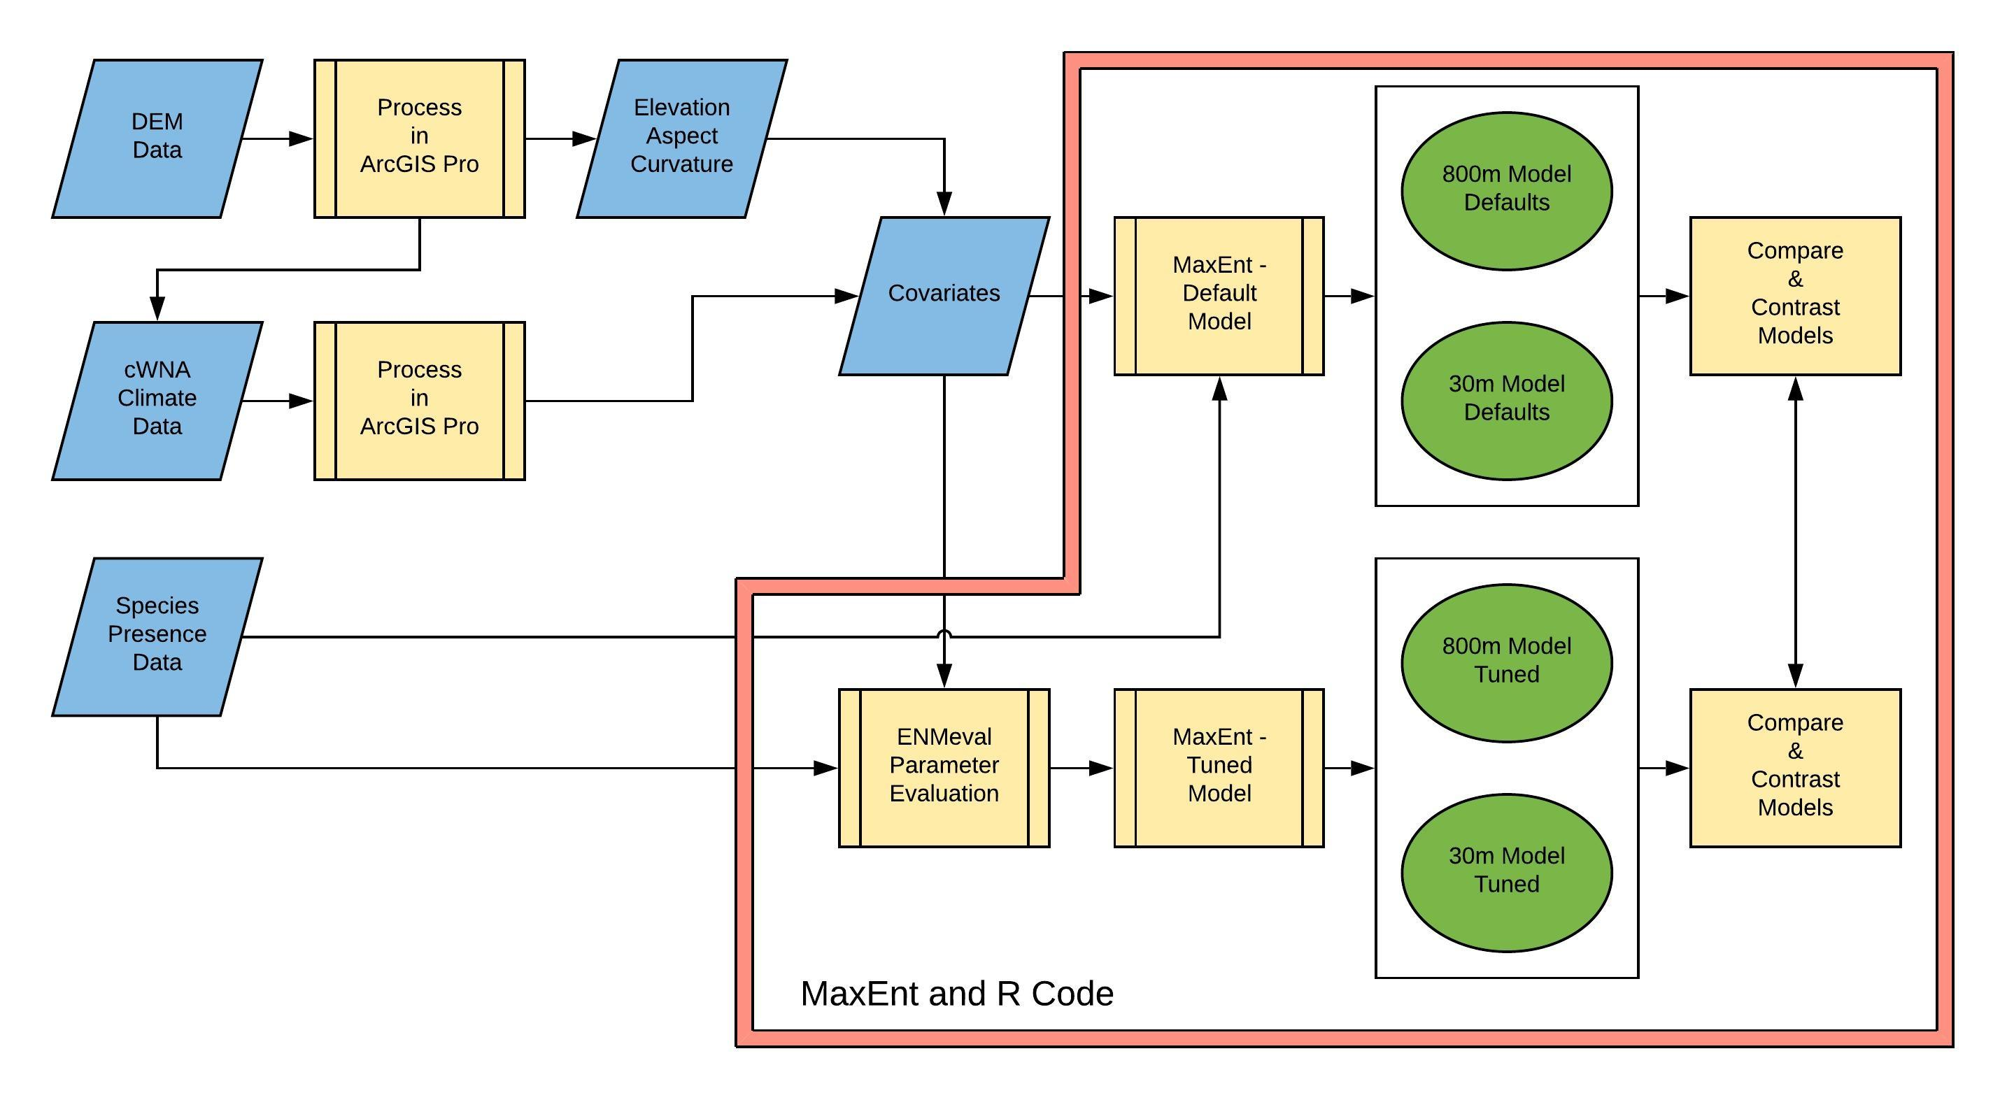
High Level Processing Flow
Notes:
Not entirely accurate.
Missing HSA analysis

Slide 17
ENMeval Tuning Process
For Each Partition Scheme (mitigate spatial bias)
Input RM set and FC set and run Maxent combinations
Regularization Multiplier (RM) set = 1, 2, 3, 4, 5
Feature Class (FC) set = L, Q, P, LQ, LQP
Did not use Hinge and Threshold FCs
200 models tested
4 partitions x 5 RM x 5 FC x 2 resolutions
“Best” model chosen per metrics
AICc primary criteria
AUC secondary criteria
Omission rates considered
Further discussion in Results section
Notes:
Speak to partial schemes. What does this address?
FC names: Linear, Quadratic, Hinge, Product, Threshold
Leave out Hinge and Threshold given sample size is <80. Also, understand that Hinge is questionable per Dr Longcore.

Slide 18
Selected Maxent Parameters
MaxEnt Parameter | Choices | MaxEnt Default | Comments | Default Model | Tuned Model
Feature Class (FC) | Linear (L) Quadratic (Q) Product (P) Threshold (T) Hinge (H) Auto | Auto | Auto FC set per sample size: Linear is always used; quadratic with at least 10 samples; hinge with at least 15; threshold and product with at least 80. Ranges can be overridden. | Auto: LQH for this dataset | LQ per ENMeval analysis
Regularization multiplier (RM) | Number >=0.5, in steps of 0.5 | 1.0 |  | 1.0 | 2.0 per ENMeval analysis
Output format | Cloglog Logistic Cumulative Raw | Cloglog | Raw recommended for comparing models of the same species. (Merow et al 2013, others) Raw required for ENMeval AICc metric. | Raw & Logistic | Raw & Logistic
Max number of background points | Number | 10,000 | Random points selected using dismo::randomPoints function rather than the Maxent function | CA: 10,000 UT: 5,000 | CA: 10,000 UT: 5,000
Maximum iterations | Number | 500 | Insure convergence of the covariate evaluation within Maxent | 500 | 5000
SECTION TITLE | 2
Notes:
MaxEnt sets FC by number of locations provided.
RM helps control for overfitting
Convergence raised on tuned model as testing showed it did not occur until 700+ iterations.

Slide 19
Evaluation Model Processing
Four final models created
Tuned and default
30-meter and 800-meter resolutions
25 iterations of each model
Random background points on each iteration
Model metrics averaged across iterations
Maxent raw output
Averaged prediction surfaces created
Maxent logistic output
California and Utah extents

Slide 20
Model Evaluation
Performance metrics
AICc
AUC
Omission Rates
orMTP
or10pct
AUC.diff
Prediction to a new extent (Utah)
AUC
Spatial comparisons
Prediction surfaces (mean of 25 iterations)
Hot spot analysis (delta = default - tuned)
SECTION TITLE | 2

Slide 21
Results

Slide 22
Tuning
Results

Slide 23
Tuning Results
Wide variation in metrics across the 200 models
Within partition schemes
Across partition schemes
Between resolutions
Top two models from each partition scheme selected for a final comparison
FC = LQ and RM = 2 selected for tuned model
Notes:
FC names: Linear, Quadratic, Hinge, Product, Threshold
Leave out Hinge and Threshold given sample size is <80. Also, understand that Hinge is questionable per Dr Longcore.
Checkerboard2
Based on cell count
800m raster 147x219
30m raster 3638x7069
Extent 50km x 200km

Slide 24
Tuning Results – 30m
AICc scores have a tight 3.2 point range
AUC scores stronger on LQ_1 and LQ_2 jackknife tests
Omission rates marginal but acceptable
Regardless of partition, all resolved to LQ_1 and LQ_2
Notes:
Because the AICc range was so tight at this point in the evaluation, the AUC became the dominant metric. However, AICc was still primary on the steps leading to this. Was much more useful in the prior sorting of best models

Slide 25
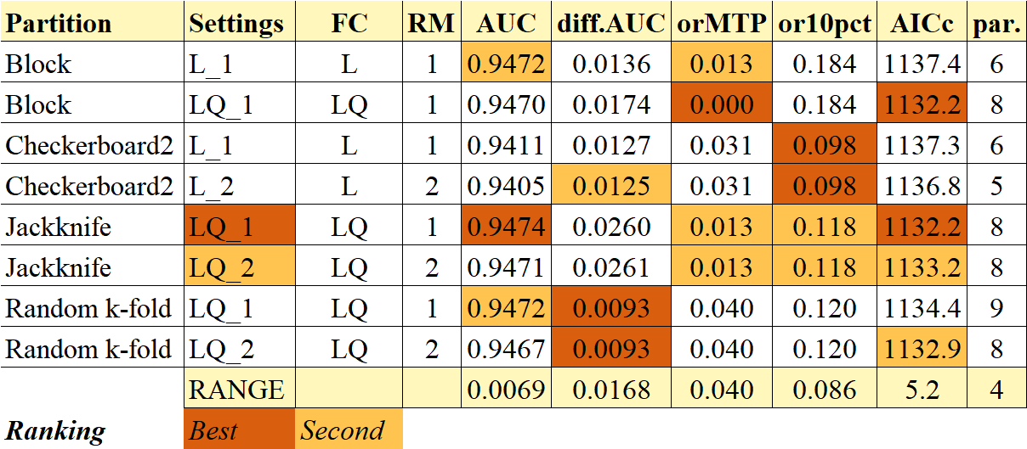
Tuning Results – 800m
More mix on model complexity than 30m results (L_1, L_2, etc.)
AICc scores have a tight 5.2 point range, but relatively broader than 30m
AUC scores close on top five models in the metric
LQ_2 chosen for consistency with 30m
Notes:
AICc score had a higher range than 30m model, but also was based on a 1100 instead of a 2100 score.

Slide 26
Model
Metrics

Slide 27
AICc
Resolution |  | AICc Default | AICc Tuned | AICc Delta | parameters Default | parameters Tuned
800m | Mean | 1235.3 | 1133.1 | 9.0% | 36.8 | 7.9
 | Median | 1229.9 | 1133.2 | 8.5% | 37 | 8
 | Range | 197.9 | 2.9 |  | 24 | 1
30m | Mean | 2339.0 | 2184.2 | 7.1% | 42.7 | 8.4
 | Median | 2312.2 | 2184.5 | 5.8% | 41 | 8
 | Range | 277.9 | 6.9 |  | 22 | 3
Marked increase in performance with tuned model
Default model more volatile as demonstrated by ranges and graphs
As reflected in AICc, reduced parameters and complexity with tuned model

Slide 28
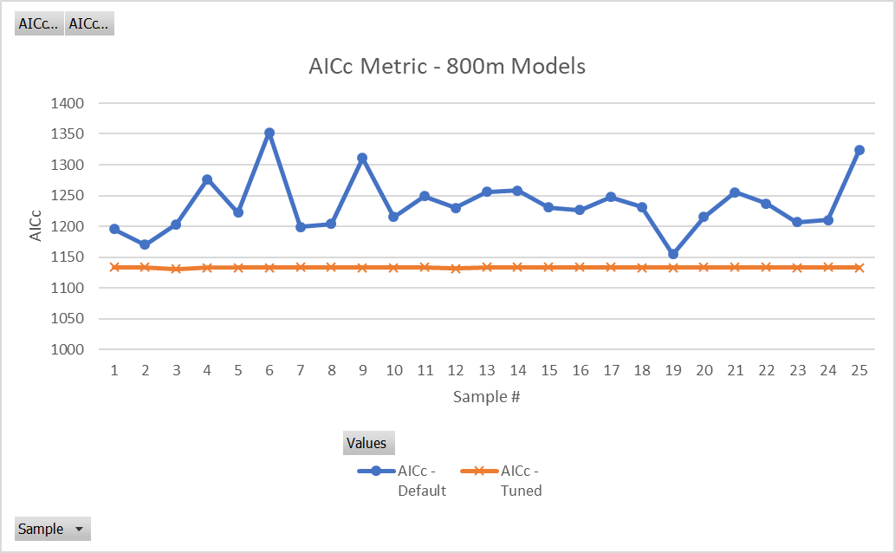
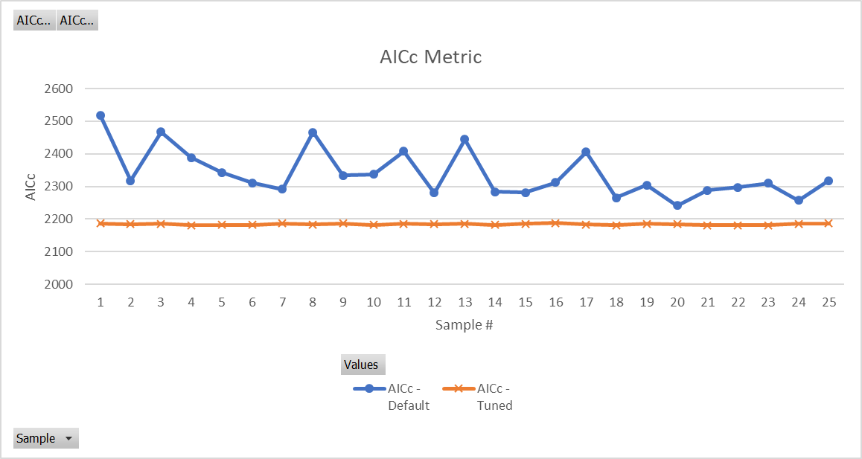

Slide 29
AUC
Resolution |  | AUC Default | AUC Tuned | AUC Delta
800m | Mean | 0.9577 | 0.9498 | -0.8%
 | Median | 0.9577 | 0.9499 | -0.8%
 | Range | 0.0033 | 0.0023
30m | Mean | 0.9569 | 0.9475 | -1.0%
 | Median | 0.9566 | 0.9472 | -1.0%
 | Range | 0.0059 | 0.0059
Little variation in AUC across iterations
<0.3% on 800m model
<0.6% on 30m model
AUC slightly lower (<=1%) on tuned reflects relaxed model
All scores indicate very good discretionary ability
Notes:
AUC:
<0.7 poor
0.7 to 0.9 moderate
>0.9 high performance

Slide 30
Omission Rates
Resolution |  | orMTP Default | orMTP Tuned | or10 Default | or10 Tuned
800m | Mean | 0.0 | 0.0 | 0.091 | 0.085
 | Median | 0 | 0 | 0.091 | 0.079
 | Range | 0.0 | 0.0 | 0.000 | 0.013
30m | Mean | 0.0 | 0.0 | 0.094 | 0.092
 | Median | 0 | 0 | 0.094 | 0.092
 | Range | 0.0 | 0.0 | 0.000 | 0.000
Small variance on the 800m tuned model for or10pct
All other omission rates flat across the iterations
Overall, no indications of overfitting from these metrics

Slide 31
Utah
Prediction

Slide 32
Utah Metrics
Resolution |  | UT AUC Default | UT AUC Tuned | AUC Delta | UT AICc Default | UT AICc Tuned | AUC Δ Default | AUC Δ Tuned
800m | Mean | 0.6976 | 0.6056 | -13.2% | NA | 376.0 | -27.2% | -36.2%
 | Median | 0.6979 | 0.6064 | -13.1% | NA | 376.5 | -27.1% | -36.2%
 | Range | 0.0264 | 0.0145 |  | NA | 7.3
30m | Mean | 0.6434 | 0.6040 | -6.1% | NA | 637.2 | -32.8% | -36.3%
 | Median | 0.6442 | 0.6018 | -6.6% | NA | 637.8 | -32.7% | -36.5%
 | Range | 0.0516 | 0.0576 |  | NA | 31.2
AUC values in the 0.6xxx range indicate poor discrimination performance
27% to 36% drop from CA values
Tuned mode significantly lower AUC than default
AICc inconclusive as default model yields NA values
Notes:
AICc yields NA when the number of parameters exceeds the number of presence locations
AUC:
<0.7 poor
0.7 to 0.9 moderate
>0.9 high performance

Slide 33
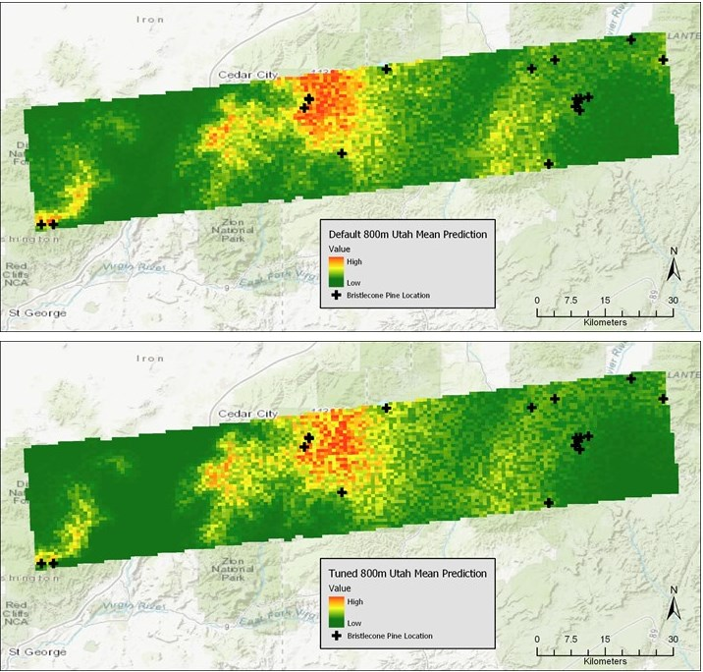
Utah 800m
Prediction
Alignment with small population in SW corner and N central area
Poor alignment across other locations

Slide 34
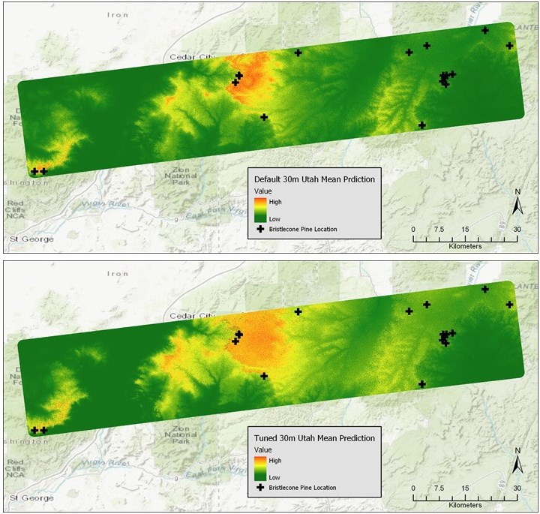
Utah 30m
Prediction

Slide 35
Spatial Analysis

Slide 36
Prediction Surfaces
Resolution Comparison
As expected, 30m more granular than 800m
30m showed higher predictions in southern and central areas than 800m
Northern area showed little difference
Tuned and Default - 800m
Results mixed. Expected more dispersal than shown.
Central and southern areas showed some upward shift in tuned
Northern area had little noticeable difference in pattern
Tuned and Default - 30m
As expected, tuned more dispersed predictions
Most apparent in northern area, less in central, limited in southern
Prediction of central and southern similar between default and tuned
Notes:
TALK TO THESE IN GRAPHICS ON NEXT PAGE

Slide 37
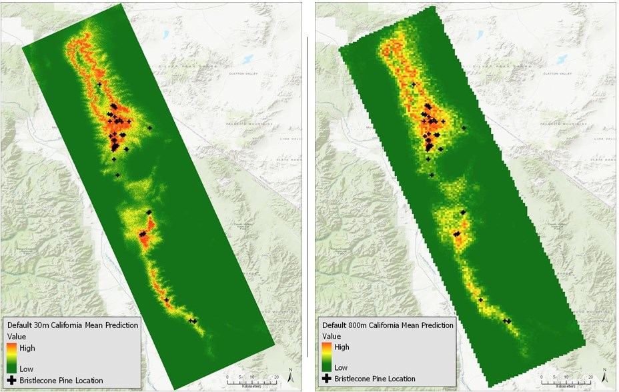
30m and 800m Default

Slide 38
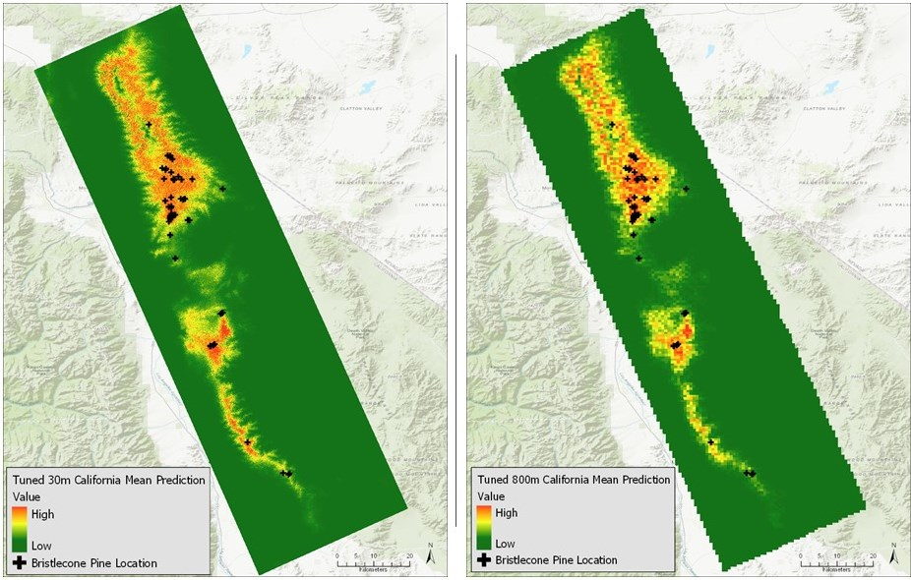
30m and 800m Tuned

Slide 39
Hot Spot Analysis
Construction
Shows where tuning changed the model predictions
Default cell values less tuned cell values (logistic output)
Four created: values, absolute values, positive only, negative only
Pos and neg HSAs most valuable
Only completed on 800m predictions due to processing issues
Positive Values
Red = high delta with default; Blue = low delta with default
Highlights where default had dominant predictions
Negative
Dealing with negative number range, reversing interpretation
Blue = high delta with default; Red = low delta with default
Highlights where tuned had dominant predictions

Slide 40
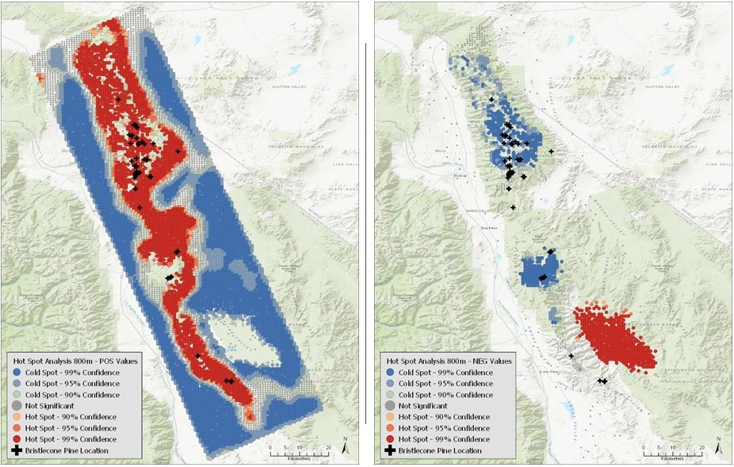
Hot Spot Analysis - Pos and Neg
Notes:
POSITVE SURFACE
Default model had higher bias for the highland areas of the extent. Red aligns with ridgeline of range
Tune model would have dispersed more values from this area
Hot spots align with the known localities of bristlecones
NEGATIVE SURFACE
Large red area is Saline Valley. Little change between models as it is a salt flat. Dead zone in either model
Cold spots (blue) indicate where the tuning shifted the predictions. Here are areas the tuned rated higher than the default model.
Dispersion presents well in northern population.
Strong cold spot in central area does not align well with localities. Speculate there is more “suitable” terrain there but either sample bias or population has not colonized the area.
Weaker presentation, but some in southern area. Localities taper off there as does the terrain.

Slide 41
Conclusions

Slide 42
Conclusions
Tuned Model More Accurate?
Yielded less complex, higher performing models
Tuned models demonstrated higher AICc
Similar AUC values across all models
Omission rates better or similar on tuned
Prediction surfaces less conclusive
Poor performance on Utah extent a concern
Higher Resolution More Accurate?
Results inconclusive
Difficult to compare metrics across resolutions
AICc of no value across resolutions
AUC similar across models
Omission rates similar
Prediction surfaces less conclusive

Slide 43
Data Uncertainty
High level of data uncertainty
compounds drawing conclusions
PRISM Data
USGS NED 90m elevation data +/-30m
Unknown impact of interpolation to 800m in PRISM elevation
Propagates to all climate data as PRISM elevation used in climate modeling
Impacts both 800m and 30m models
ClimateWNA
Impacts of 200m limits not obvious in results
However, resolution issues are present, with unknown impact
Compounded by underlying uncertainty of the base PRISM data
Primary impact on 30m models

Slide 44
Further Study
Strong need for baseline metrics to use across models
Climate variables issues, especially at high resolution
Interpolation methods
Appropriateness at what scale?
ClimateWNA impacts at <200m
Use of HSA to analyze model outputs
Evidence of spatial bias in this dataset
Block and some checkerboard schemes in tuning
Results of Utah predictions

Slide 45
Q&A
Discussion

Slide 46
Ancillary Slides

Slide 47
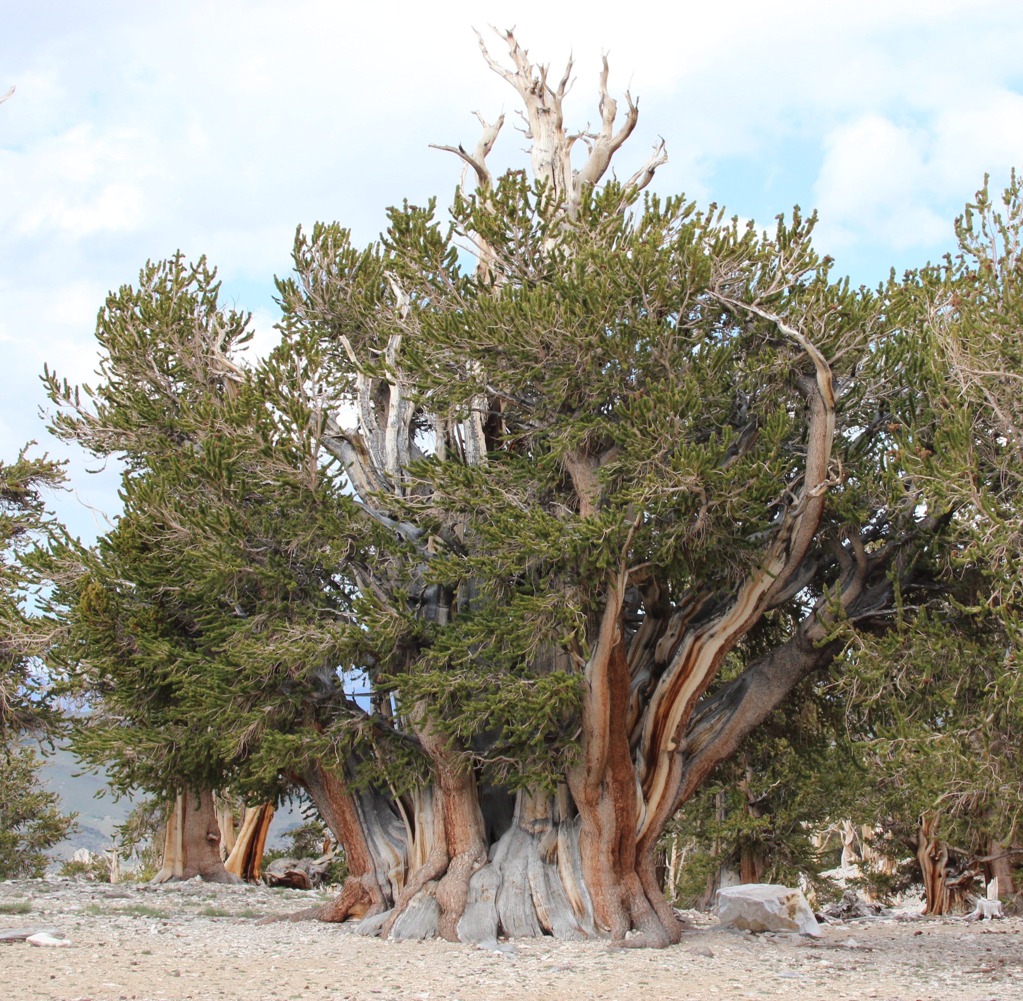
Species Selection
Bristlecone Pine
(Pinus longaeva)
High elevation niche with high relief terrain
Limited habitat range
Small set of key climate variables
Sufficient presence data
SECTION TITLE | 2
Notes:
High relief terrain challenges the modeling at both resolutions

Slide 48
Bristlecone Presence Data
Global Biodiversity Information Facility (GBIF)
Diverse source of pooled data
Most from collections, prior studies, etc.
Some iNaturalist data in recent years
362 records in original download
Data Cleansing Applied
Balance of quality and need for adequate sample
Conservative approach to remove questionable data
Reason for Removal | Count
Location outside of study area (e.g. New Zealand, Berkeley) | 5
No observation date | 23
Coordinate uncertainty >1km | 87
Collection comments question observation validity | 6
Duplicate records (i.e. same date and coordinates) | 61
Total Records Removed | 182
SECTION TITLE | 2
Notes:
iNaturalist data sometimes faulted for false identification, poor quality
Does not appear to be an issue in this dataset. About 10% of original data pool.

Slide 49
DEM Selection
PRISM 800m Elevation Data
Basis of PRISM climate data
PRISM data commonly used in habitat studies
Interpolated from USGS NED 3 arc-sec DEM
Vertical accuracy +/- 30m
USGS 3DEP 1 arc-sec (30m) Seamless DEM
Models terrain complexity of the area
Derived from photogrammetrically produced contours
LT4X linear interpolations in study area
No LIDAR sources
Balance of resolution versus model complexity
SECTION TITLE | 2
Notes:
GCS North America 1983, NAD 83 datum
North American Vertical Datum of 1988 (NAVD 88)
Vertical resolution of NED 3 arc-sec data appears to be +/-30m. Per specs from 2000 fact sheet. Also references in a couple of other documents.
PRISM DEM
modified Gaussian filter 80m>800m
truly circular averaging area
weights the surrounding grid cells in a Gaussian, or normal, distribution with distance

Slide 50
Covariate Selection
Why the chosen covariates?
Key variables as indicated by species and tree line studies
Keeping it simple (i.e. spatial focus of study)
DEM Derivatives
Elevation
Aspect
Northness (cos)
Eastness (sin)
Curvature
Climate
Mean annual temperature (MAT)
Mean warmest month temp (MWMT)
Mean coldest month temp (MCMT)
Degree-days < 0C (DD0)
Inverse proxy for growing season
PRISM 30-year NORMALS (1981-2010)
Shifted down 1.5C
SECTION TITLE | 2

Slide 51
Climate Data
Climate Models Considered
WorldClim
PRISM
Why PRISM climate data?
Well respected and widely used climate model
Rasters interpolated from weather station data and climate models
Includes expert-based algorithms for inversion areas, rain shadows, coastal effect
Performs well in mountainous terrain
ClimateWNA
Web and desktop application
Interpolates PRISM data to chosen resolution
Provides seasonal variables
Has some caveats…
SECTION TITLE | 2

Slide 52
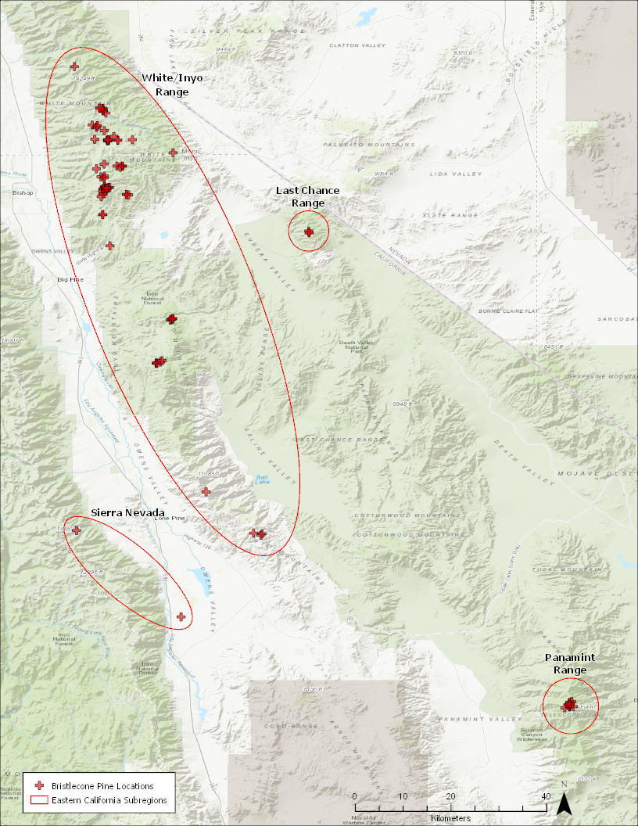
Study Area Selection
4 California Sub-regions
White Mtn/Inyo Mtn Range
Last Chance Range
Sierra Nevada
Panamint Range
Subregion | Count
White Mountain/Inyo Mountain Range | 76
Last Chance Range | 3
Sierra Nevada | 2
Panamint Range | 28
SECTION TITLE | 2

Slide 53
MaxEnt Tuning - ENMeval
What is ENMeval?
R package written in response to concerns about MaxEnt presence data bias and model parameter choices
Why use ENMeval?
Facilitates running of multiple MaxEnt model configurations
Facilitates partitioning schemes for training data
Generates metrics to aid in tuning model parameters
Uses MaxEnt Java program to build evaluation models
Does not alter source data
Does not select parameters
SECTION TITLE | 2
Notes:
MaxEnt sets FC by number of locations provided.
RM helps control for overfitting

Slide 54
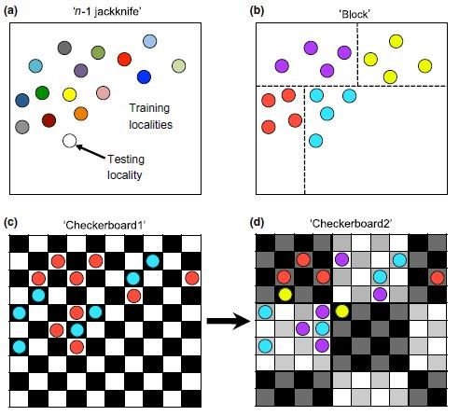
ENMeval - Partitioning
Partitioning Scheme | Description
Jackknife | Each of n localities used once for test. Results averaged across all n.
Random k-fold | Localities randomly placed into k number of bins (k set by user). Equivalent to MaxEnt’s cross-validate partitioning.
Block | 4 spatial bins with equal number of localities in each bin.
Checkerboard1 | 2 bins, but in a checkerboard/chessboard pattern. Uneven locality distribution.
Checkerboard2 | 4 bins, with and additional layer of aggregation from checkerboard1.
User defined | User creates spatial and locality partitioning based on study requirements.
Training/Test Partitions
k model iterations
k-1 bins for training
Metrics summarized across iterations
(Source: Muscarella et al. 2014)
Notes:
Block focuses on equal sample size
Checkerboard focuses on equal environment space
Warning given if <4 bins created with checkerboard
I need to test to see what k works best for random k-fold and checkerboard

Slide 55
ENMeval - Tuning Metrics
AUC.Test
AUC based on test locations only, averaged across iterations. Indicates how well does model distinguish localities from background.
AUC.diff
Difference between AUC.Train and AUC.Test , averaged across iterations. Positively associated with degree of overfitting.
orMTP and or10pct
Omission rates above thresholds. Rates > target (0% and 10%) indicate overfitting.
AICc
AIC corrected for small sample size. Indicates model goodness-of-fit and complexity.
SECTION TITLE | 2
Notes:
Selecting appropriate metrics for the models proved to be difficult. Not much consensus on what should be used across models for comparisons. Lots of issues with the various measures.
AUC: how well is the model distinguishing locations from background
OM: indicates proportion of test locations lower than the lowest ranking training locations. 10% excludes the lowest 10% of training sites.
AICc: lower better

Slide 56
Model Comparisons
Model 1
800m
Default
Model 3
800m
Tuned
Default vs Tuning
Resolution
Resolution
Model 2
30m
Default
Model 4
30m
Tuned
Default vs Tuning

Slide 57
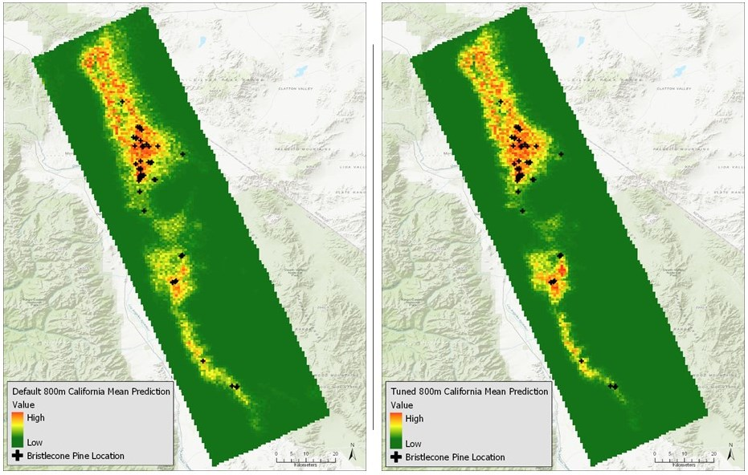
800m Default and Tuned

Slide 58
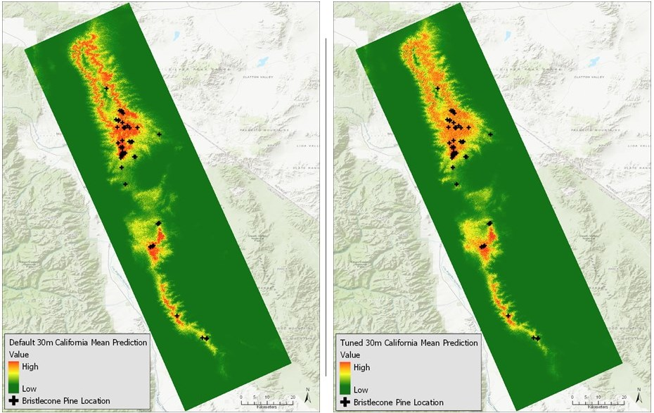
30m Default and Tuned

Slide 59
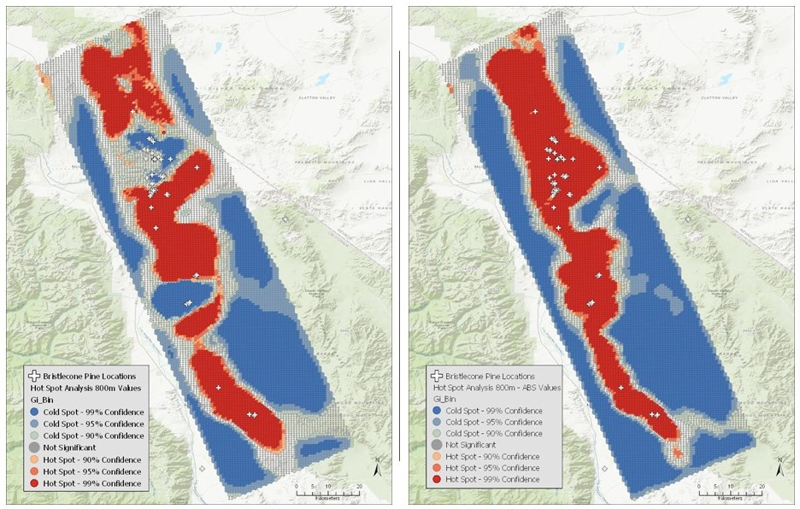
Hot Spot Analysis - Raw and Abs

